Slide 1
Analytical methods
Instrumental methods of analysis:
The instrumental methods of analysis are based on the measurement of various physical and or chemical properties of the analytes.
These methods require the sensing probes or electronic gadgets to measure and quantify the physical/chemical property.

Slide 2
Analytical methods
Modern methods of analysis
Sl. No. | Instrumental method | Characteristic property
1 | Kinetic methods | Rate of reaction
2 | Conductometry | Electrical resistance
3 | Potentiometry | Electrical potential
4 | Polarimetry | Rotation of radiation
5 | Refractometry | Refraction of radiation
6 | Spectrophotometry and photometry (X-ray, UV, Visible, IR) | Absorption of radiation
7 | Emission spectroscopy | Emission of radiation
8 | Raman spectroscopy | Scattering of radiation
Instrumental techniques are more sensitive than classical techniques
The instrumental procedures employ is more sophisticated or costlier apparatus.

Slide 3
Potentiometric titration
An important electroanalytical technique based on the measurement of the potential of electrochemical cells without drawing appreciable current.
In this technique absolute potentials w.r.t a standard half-cell is not required and the measurements are made when the titration is in progress.
No indicator is used; instead the voltage across the analyte, typically an electrolyte solution is measured

Slide 4
EMF of the cell depends on the concentration of the electrolytes with which the electrodes are in contact. Therefore, the electrode reaction is
M^{n+} + ne⁻----->M
As the concentration of M^{n+} changes, the EMF of the cell also changes correspondingly. Thus the potentiometric titration involves measurement of EMF between indicator electrode and reference electrode, with the addition of titrant.

Slide 5
Potentiometric titration
In potentiometric titrations the change in the electrode potential upon the addition of titrant are noted against the volume of titrant added.
The potential of an electrode is given by Nernst equation
E = E⁰ + 0.0591 / n log [ M ^{n+} ]
Thus the potential of an electrode depends upon concentration of the ion to which it is reversible.

Slide 6
Theory-Nernst equation
Nernst equation is the basis for the relationship between the voltage generated by an electrochemical cells a result of the two half cell reactions and the relevant concentration at each electrode.
E = Eº + (2.303RT/2F) log [oxidised] / [reduced]

Slide 7
Kinds of titration
(1) Acid-base
(2) Redox
(3) Precipitation titration
It is used when the end points are very difficult to determine, either when
(1) Very diluted solution
(2) Coloured and turbid solution
(3) Absence of a suitable indicator

Slide 8
It is a regular titration but instead of the indicator we used the potentiometer.
Instruments requirement:-
Combined glass electrode (double function electrode)
Potentiometer pH meter
Redox (mV)
Magnetic stirrer
Hot-plate (use the stirrer and make sure heat is off)
Magnet capsule

Slide 9
Objectives
Titration of a weak acid (acetic acid) against a strong base (NaOH)
Stock solution:-
Unknown acetic acid solution
0.1N NaOH

Slide 10
Experiment
Fill the burette with the standard titrant.
Pipette 5 mls of acetic acid sample into 100 mls beaker and dilute to 50 by distilled water.
Put a magnet stirrer and dip in the combined electrode ( make sure that the bulb of the electrode and the junction bridge are dipped completely under the water.

Slide 11
Switch on the stir and allow few second before reading the pH of the solution.
start the titration by adding 0.5 mls of the titrant, stir well and then read the pH of the solution .
Continue titration as before until near the end point ( pH change is grater than 0.2 ) , add small portion of the titrant ( 0.1mls), stir well then take the pH reading.

Slide 12
Repeat until about 10 mls of the standard titration has been added.
Plot the potentiometric curve ( pH value against ml of the titrant ) , determine the end point from the curve and calculate any required data.

Slide 13
Background
Consider the following graph:

Slide 14
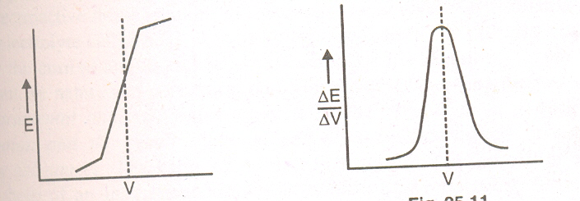
Fig shows the second derivative for the data changes sign at the point of inflection.
This change is used as the analytical signal in some automatic titrators.
The point at which the second derivative crosses zero is the inflection point, which is taken as the end point of the titration; this point can be located quite precisely.

Slide 15
Advantages
1. The apparatus required is generally inexpensive, reliable and readily available
2. It is easy to interpret titration curves
3. The method can be used for colored solutions
4. The method is applicable for analysis of dilute solutions
5. Several components can be titrated in the same solution without the possibility of indicators interfering with each other. Eg bromide and iodide may be titrated together.

Slide 16
Application
Calculation of p^{H} of buffer mixture of weak acid and its salt (Henderson- Hasselbalch equation)
Consider buffer solution of weak acid HA and its highly dissociatd salt NaA. The hydrogen ion concentration of such a solution is given by
[H⁺] = K_{a} [Acid]/ [Salt]
-log[H⁺] = -logK_{a} + log [Acid]/ [salt]
pH = pK_{a} + log [Acid]/ [Salt]
Henderson- Hasselbalch equation helps to calculate the p^{H} of buffer mixture of weak acid and its salt.

Slide 17
Conductometric titration
Conductometric titration is used to measure the amount of analyte present in the given solution by measuring the change in conductance as a function of volume of titrant.
During a titration process, one ion is replaced with another and the difference in the ionic conductivities of these ions directly impacts the overall electrolytic conductivity of the solution.
In Conductometric titration, concentration of the titrant must be 10 times as the solution being titrated. Since, a sharp observable change in the value will be observed by the addition of a single drop of titrant when the end point is near.
In conductometric titration, Equivalence point is determined graphically.
The conductance of the solution depends on
i)The number and charge on the free ions
ii)Mobility of ions

Slide 18
Terms used in Conductometric Titration
Titrant – A solution used in titration whose concentration is known and is added to another solution of unknown concentration to determine its concentration.
Analyte – The solution used in titration whose concentration is unknown.
Equivalence Point – The point in conductometric titration at which conductivity undergoes a sudden change.

Slide 19
Advantages
It does not require indicators as titration is based on the conductance of the solution and endpoint or neutralization point is determined graphically.
It is suitable for colored solutions as well.
As the endpoint is determined graphically, results are more accurate with minimum error.
It is used for the analysis of turbid suspensions, weak acids, weak bases, a mixture of weak and strong acids, etc.

Slide 20
Limitations
High concentration of salts in solution does not give accurate results.
Presence of other electrolytes other than the species to be analyzed will not give accurate results.
Limited use for redox titration

Slide 21
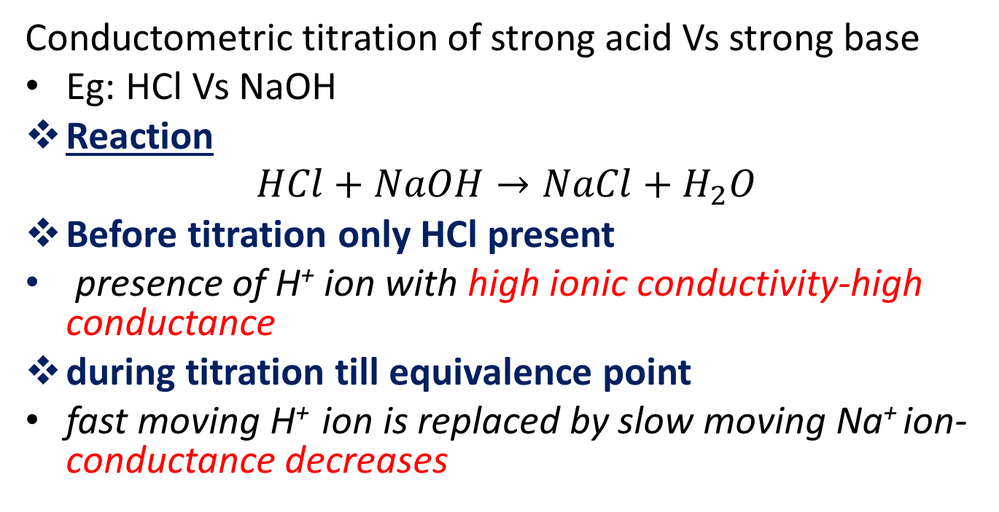
Different type of acid-base conductometric titration
Conductometric titration of strong acid Vs strong base
Eg: HCl Vs NaOH
Reaction
$$HCl+NaOH→NaCl+H_{2}O$$
Before titration only HCl present
presence of H⁺ ion with high ionic conductivity-high conductance
during titration till equivalence point
fast moving H⁺ ion is replaced by slow moving Na⁺ ion-conductance decreases

Slide 22
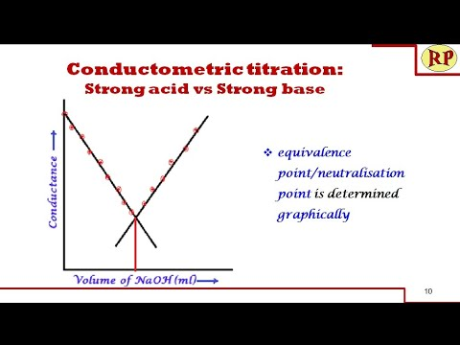
At equivalence point
NaCl & H₂O present-least conductance
After equivalence point
Excess NaOH added- accumulation of OH⁻ ion with high ionic conductivity-conductance increases

Slide 23
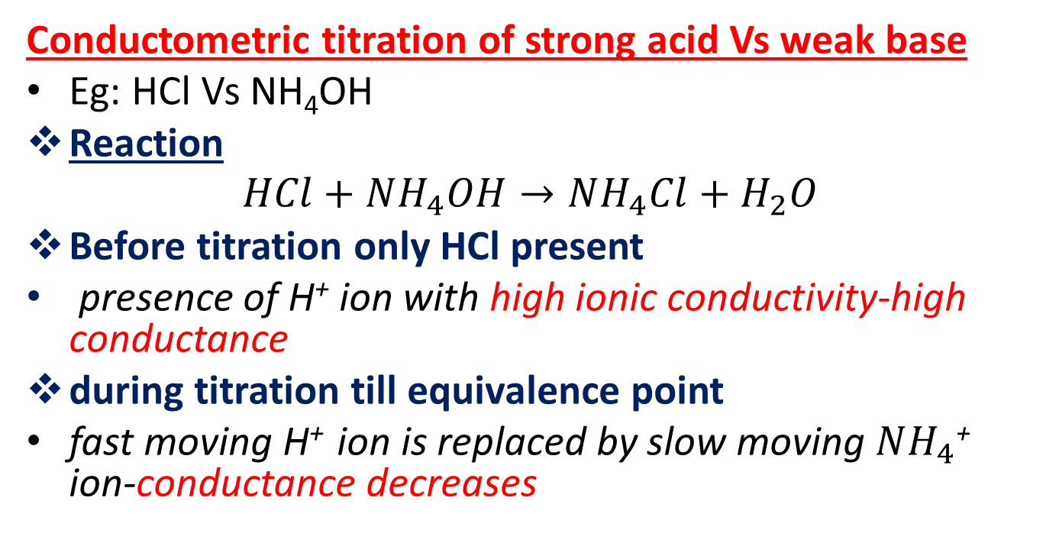
Conductometric titration of strong acid Vs weak base
Eg: HCl Vs NH₄OH
Reaction
$$HCl+NH_{4}OH→NH_{4}Cl+H_{2}O$$
Before titration only HCl present
presence of H⁺ ion with high ionic conductivity-high conductance
during titration till equivalence point
fast moving H⁺ ion is replaced by slow moving $NH_{4}$⁺ ion-conductance decreases

Slide 24
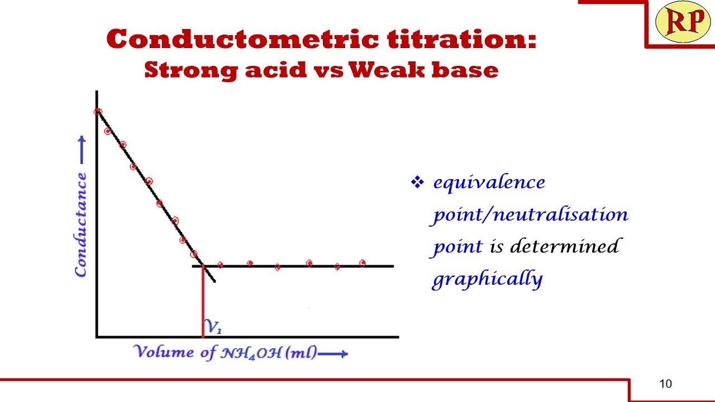
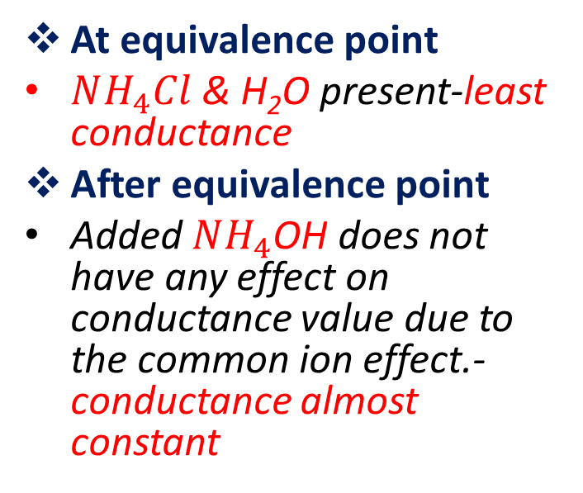
At equivalence point
$NH_{4}Cl$ & H₂O present-least conductance
After equivalence point
Added $NH_{4}$OH does not have any effect on conductance value due to the common ion effect.- conductance almost constant

Slide 25
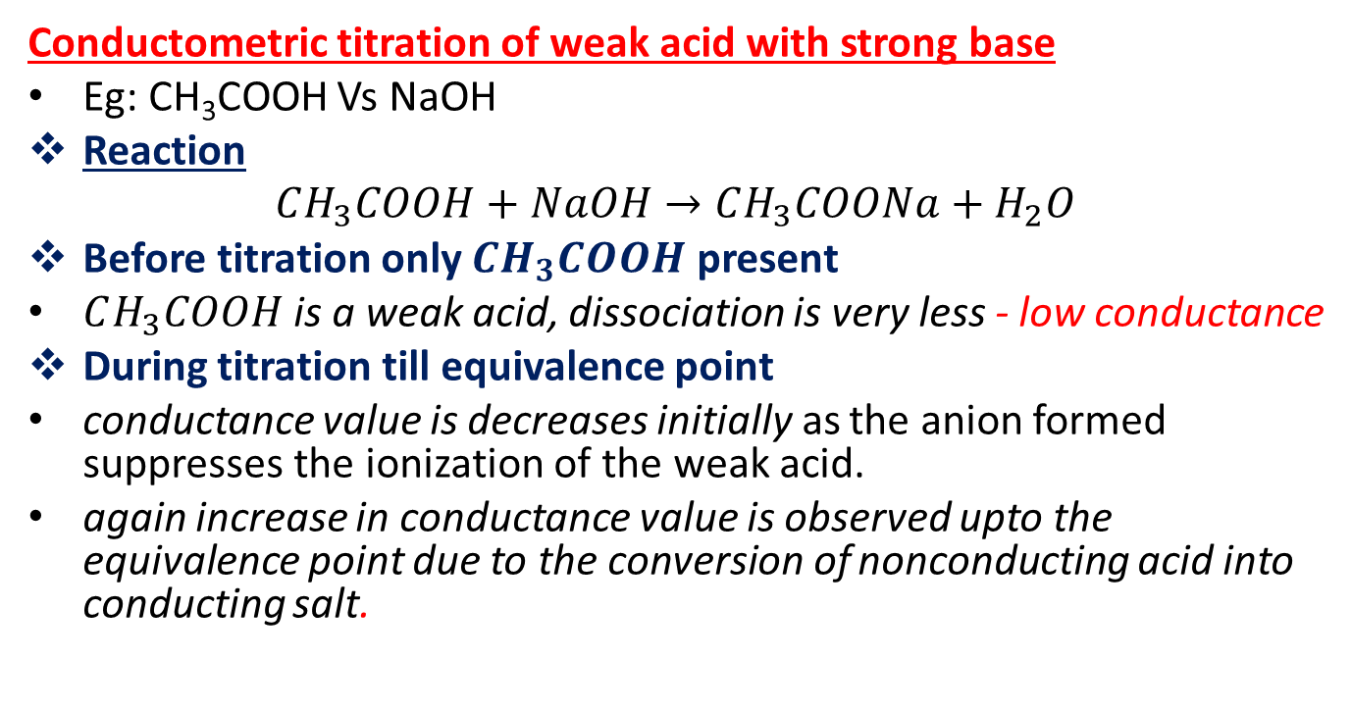
Conductometric titration of weak acid with strong base
Eg: CH₃COOH Vs NaOH
Reaction
$$CH_{3}COOH+NaOH→CH_{3}COONa+H_{2}O$$
Before titration only $CH_{3}COOH$ present
$CH_{3}COOH$ is a weak acid, dissociation is very less - low conductance
During titration till equivalence point
conductance value is decreases initially as the anion formed suppresses the ionization of the weak acid.
again increase in conductance value is observed upto the equivalence point due to the conversion of nonconducting acid into conducting salt.

Slide 26
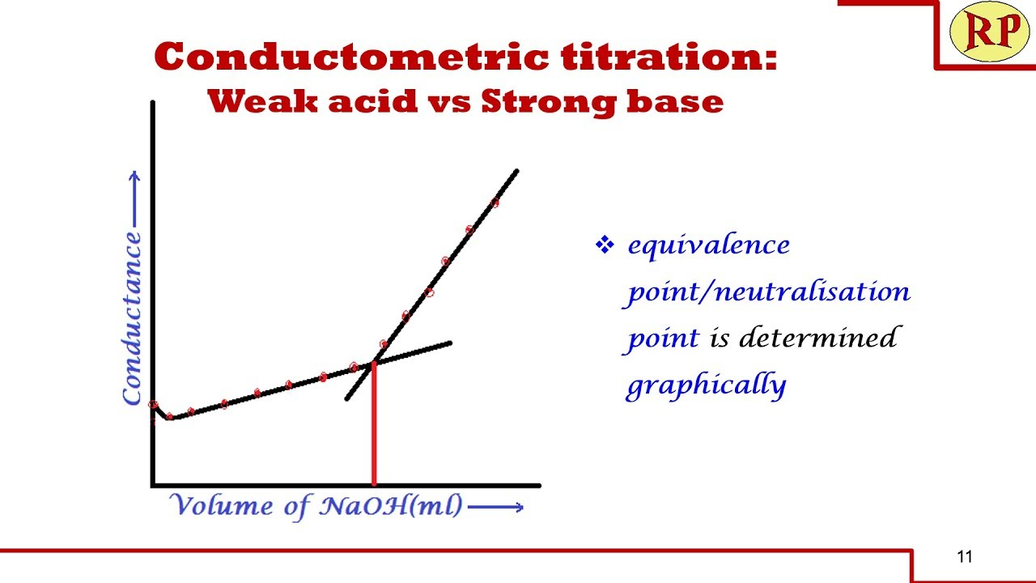
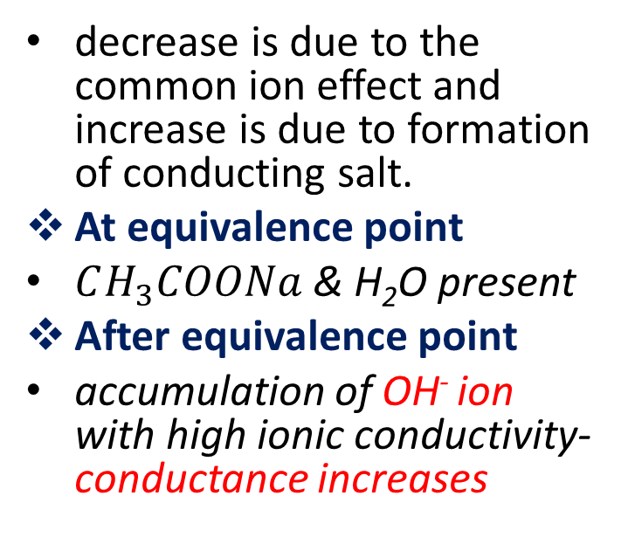
decrease is due to the common ion effect and increase is due to formation of conducting salt.
At equivalence point
$CH_{3}COONa$& H₂O present
After equivalence point
accumulation of OH⁻ ion with high ionic conductivity-conductance increases

Slide 27
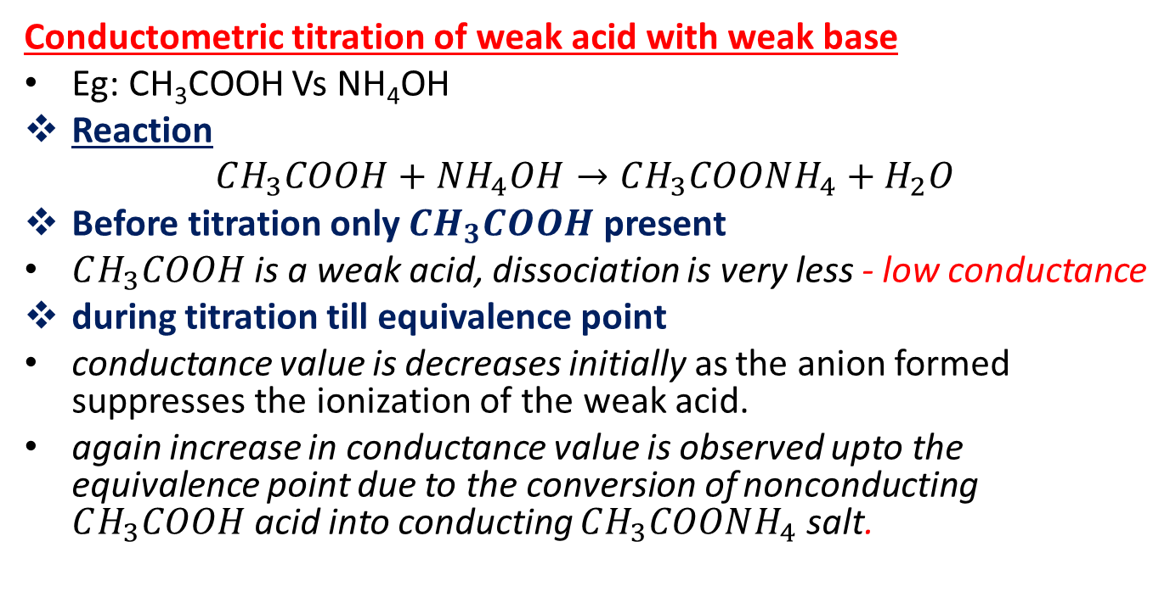
Conductometric titration of weak acid with weak base
Eg: CH₃COOH Vs NH₄OH
Reaction
$$CH_{3}COOH+NH_{4}OH→CH_{3}COONH_{4}+H_{2}O$$
Before titration only $CH_{3}COOH$ present
$CH_{3}COOH$ is a weak acid, dissociation is very less - low conductance
during titration till equivalence point
conductance value is decreases initially as the anion formed suppresses the ionization of the weak acid.
again increase in conductance value is observed upto the equivalence point due to the conversion of nonconducting $CH_{3}COOH$acid into conducting $CH_{3}COONH_{4}$salt.

Slide 28
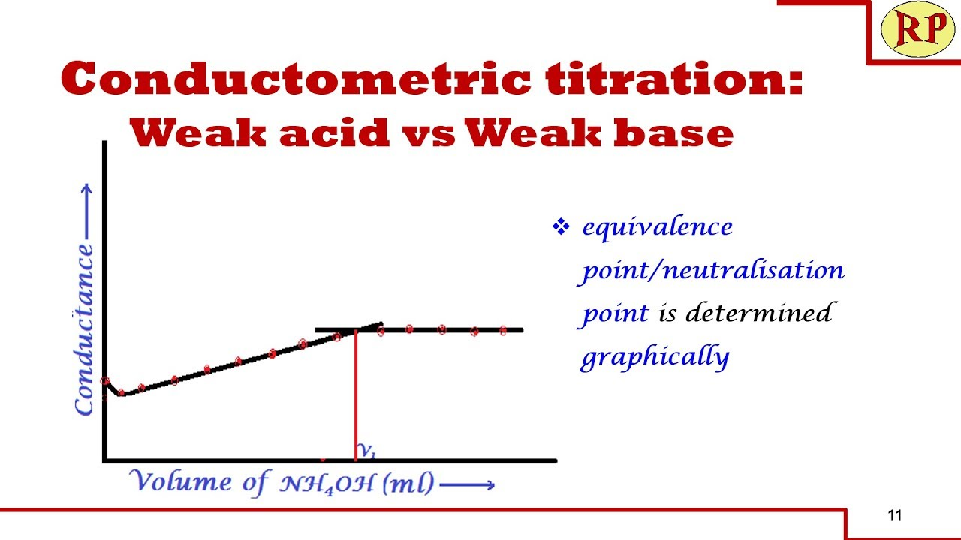
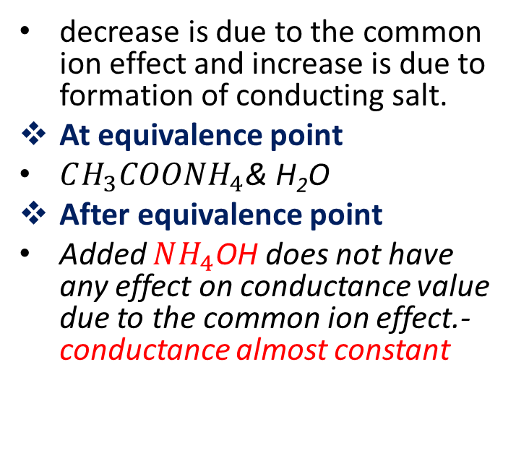
decrease is due to the common ion effect and increase is due to formation of conducting salt.
At equivalence point
$CH_{3}COONH_{4}$& H₂O
After equivalence point
Added $NH_{4}$OH does not have any effect on conductance value due to the common ion effect.- conductance almost constant

Slide 29
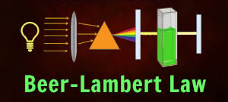

Slide 30
Spectrophotometry:
When a monochromatic light of initial intensity Io passes through a solution in a transparent vessel, some of the light is absorbed so that the intensity of the transmitted light I is less than Io.
There is some loss of light intensity from scattering by particles in the solution and reflection at the interfaces, but mainly from absorption by the solution.
The relationship between I and Io depends on the path length of the absorbing medium, b and the concentration of the absorbing solution, c.

Slide 31
Lambert’s law:-
When a ray of monochromatic light passes through an absorbing medium, its intensity decreases exponentially as the length of the medium absorbing increases.
Beer’s law:-
When a monochromatic light passes through an absorbing medium, its intensity decreases exponentially as the concentration of the medium absorbing increases.
Transmittance:-
The ratio of intensities is known as the transmittance (T), and this is usually expressed as the percentage.

Slide 32
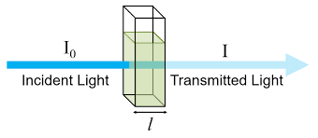
The probability that the photons of a beam of intensity I will be absorbed by the sample is directly proportional to the concentration and thickness of the absorbing solution, and it can be expressed as
dI/I = -αCdx …………. (2)
Where dI= Change in intensity produced by absorption of
radiation
dx= Thickness of the medium
C = Concentration of solution
α = Proportionality constant
- = reduction in intensity
Integration of Eq 2. between limits I =I₀ at = 0 and I = I & x =b gives,

Slide 33
According to equation 3, the intensity of a beam of monochromatic radiation decreases exponentially with an increase in the thickness ‘b’ and the concentration ‘c’ of the medium. This is Beer-Lambert law.
Putting α/2.303 = ε and defining log (I₀/I) as absorbance, A of the solution, we get
A= log (I₀/I) = εbc ………….. (4)
Where ε = Extinction coefficient of the medium
It is the characteristic of the solute and depends on the nature of the solvent, temperature, and wavelength of the radiation employed.
ln (I/I₀) = 2.303 log (I/I₀) = - αbc ………….. (3)

Slide 34
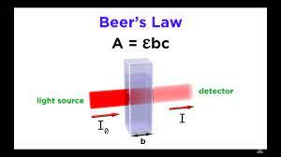
When the concentration is expressed in mol dm⁻³ and the path length in cm, then ε is expressed in dm³ mol⁻¹ cm⁻¹ is referred as molar absorption coefficient or molar extinction coefficient.

Slide 35
Limitations of the Beer-Lambert law:
Chemical and instrumental factors limit the linearity of the Beer-Lambert law. The probable causes of nonlinearity are:
Deviations in absorptivity coefficients at high concentrations (>0.01M) due to electrostatic interactions between molecules nearby
Scattering of light due to particulates in the sample
Fluorescence or phosphorescence of the sample
Changes in refractive index at a high analyte concentration
Shifts in chemical equilibria as a function of concentration
Non-monochromatic radiation, deviations can be minimized by using a relatively flat part of the absorption spectrum such as the maximum of an absorption band
Stray light

Slide 36
Numerical:
The molar extinction coefficient of phenanthroline complex of iron (II) is 1200 dm³ mol⁻¹ cm^{-1,} and the minimum detectable absorbance is 0.01. Calculate the minimum concentration of the complex that can be detected in the experiment if the path length is 1.00 cm.
A = εbc
c = A/εb = 0.01 / 1.00 * 1200
= 8.33 x 10⁻⁶ M

Slide 40
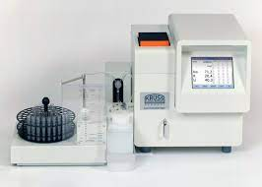

FLAME PHOTOMETRY

Slide 41
Background
Sodium ion is the major cation of the extra cellular fluid whereas potassium is the major ion found inside the cells.
The body maintains a delicate balance of these ions across the cellular membrane and any alteration in their normal values has significant physiological consequences.
For example, an abnormal increase of potassium (hyperkalemia) or decrease of potassium (hypokalemia) can significantly affect the nervous system and heart, and if the levels become extreme, it can be fatal.

Slide 42
Principle:
When the solution containing a metallic compound of Na, K, Li, Ca and Ba is aspirated into a flame, a vapour containing the atoms of the metal may be formed.
Some of these gaseous metal atoms may be raised to an energy level which is sufficiently high to permit the emission of radiation, which is characteristic of that metal

Slide 43
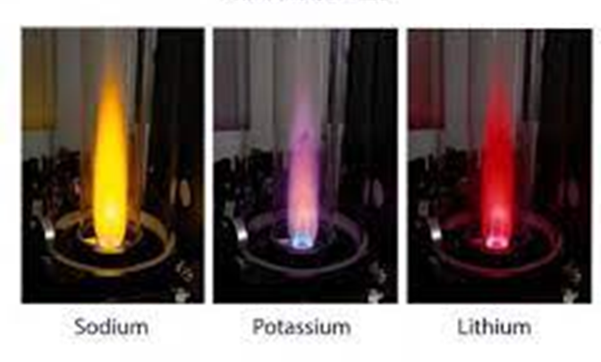
(Eg, the characteristic yellow colour imparted to flames by compounds of sodium and Lilac colour imparted to flames by compounds of Potassium).
This radiation can be measured by the detectors.

Slide 44
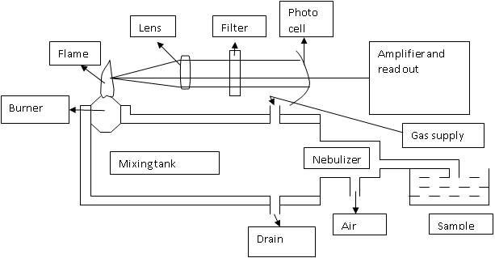
Instrumentation

Slide 45
References
(1) SPECTROSCOPY (ATOMIC AND
MOLECULAR) :- GURDEEP R. CHATWAL,
SHAM K. ANAND
(2) INSTRUMENTAL METHODS OF CHEMICAL
ANALYSIS :- GURDEEP R. CHATWAL, SHAM K.
ANAND
(3) FUNDAMENTALS OF MOLECULAR SPECTROSCOPY :- COLIN N. BANWELL AND ELAINE E. McCASH
(4) FUNDAMENTALS OF ANALYTICAL CHEMISTRY:-
SKOOG, WEST, HOLLER, CROUCH
(5) ELEMENTARY ORGANIC SPECTROSCOPY:-
Y.R. SHARMA

